Slide 1
E-Learning Management System (ELMS)
By: Patel Bansari (24MCA055)
& Trivedi Aditya (24MCA113)
Guide: Mr. Kaushal Gor
Smt. CMPICA, CHARUSAT

Slide 2
Project Profile & Company Profile
Project Name: E-Learning Management System
Description:
ELMS is a centralized web-based platform designed for interaction between students, teachers, and administrators. It provides course enrollment, content delivery, resume-based teacher recruitment, and password reset via email.
Team Size: 2 Members
Front End: HTML, CSS, JavaScript, Bootstrap
Back End: Python (Django), SQLite3
Tools: PyCharm, VS Code

Slide 3
Introduction to Tools
Front End Tools:
HTML, CSS, JavaScript, Bootstrap, jQuery
(Responsive, interactive design framework)
Back End Tools:
Python (Django): Full-stack framework with built-in features
SQLite3: Lightweight database engine used by Django

Slide 4
System Study (Requirement Analysis)
Existing System:
- Manual/fragmented interactions
- Course materials shared via email/offline
Proposed System:
- Centralized platform integrating courses, recruitment, notifications
Scope:
- Course management, content delivery, recruitment, password reset
Objectives:
- Digitize academics, improve communication, centralize workflows
Feasibility:
- Technical: Python+Django, SQLite3
- Economic: Open-source tools, minimal cost
- Operational: Easy-to-use role-based access

Slide 5
System Analysis
Requirement Specifications:
Developer: 4GB RAM, 128GB ROM, i5 processor
Software: Windows/Linux/Mac, PyCharm, Chrome
User: Browser + Internet
Includes diagrams:
Use Case Diagram
Activity Diagram
Class Diagram

Slide 6
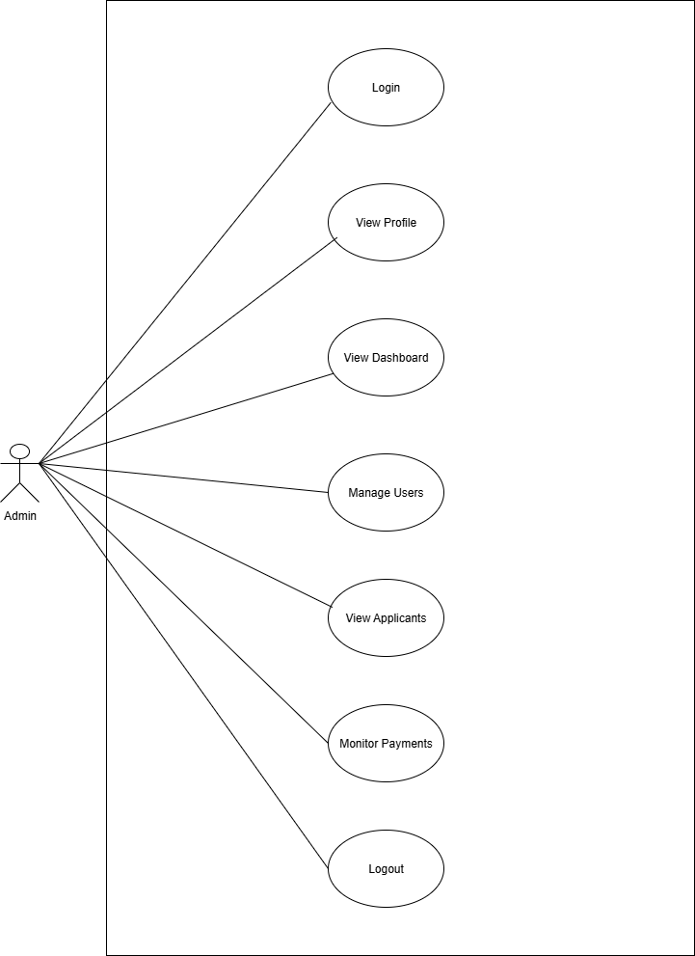
Use Case ADMIN

Slide 7
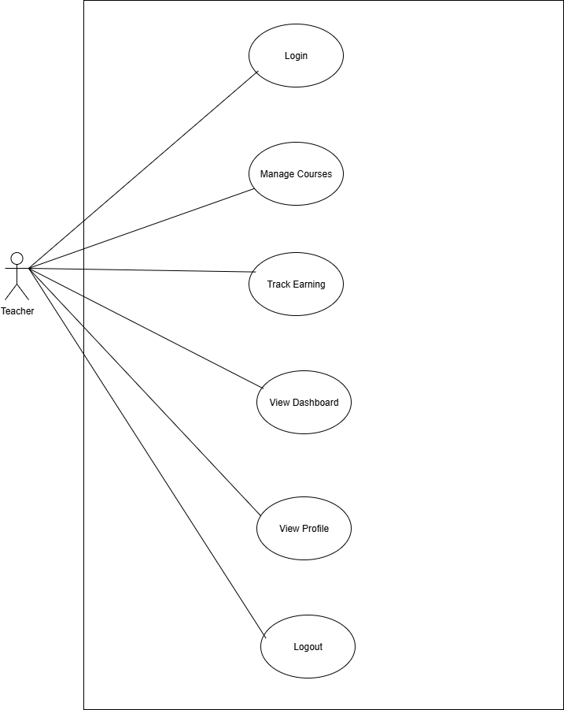
TEACHER

Slide 8
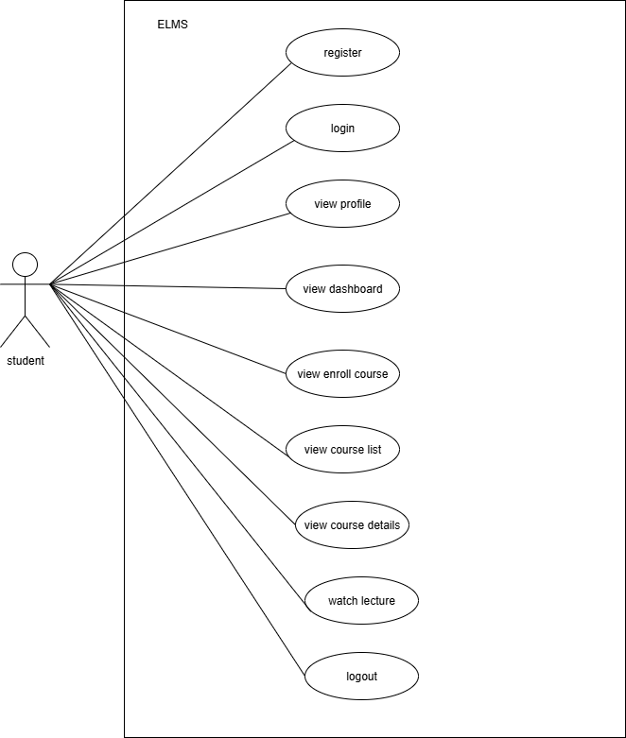
STUDENT

Slide 9
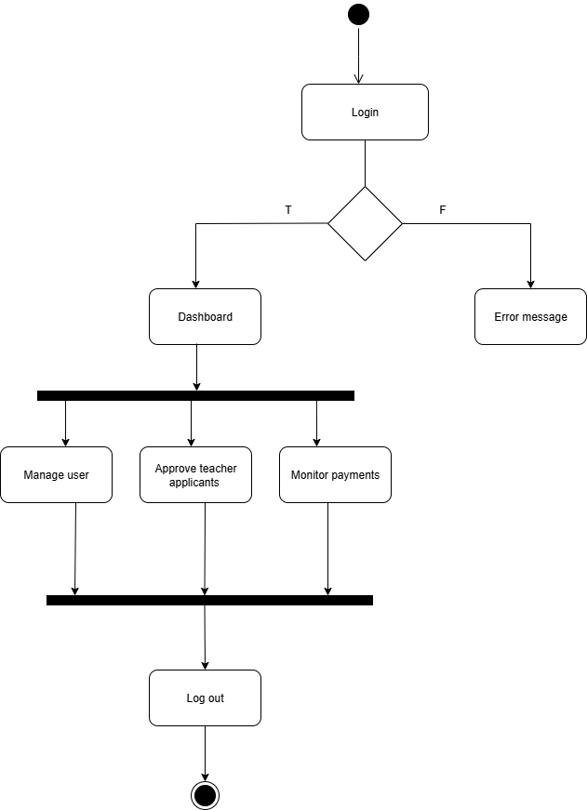
Activity Diagram ADMIN

Slide 10
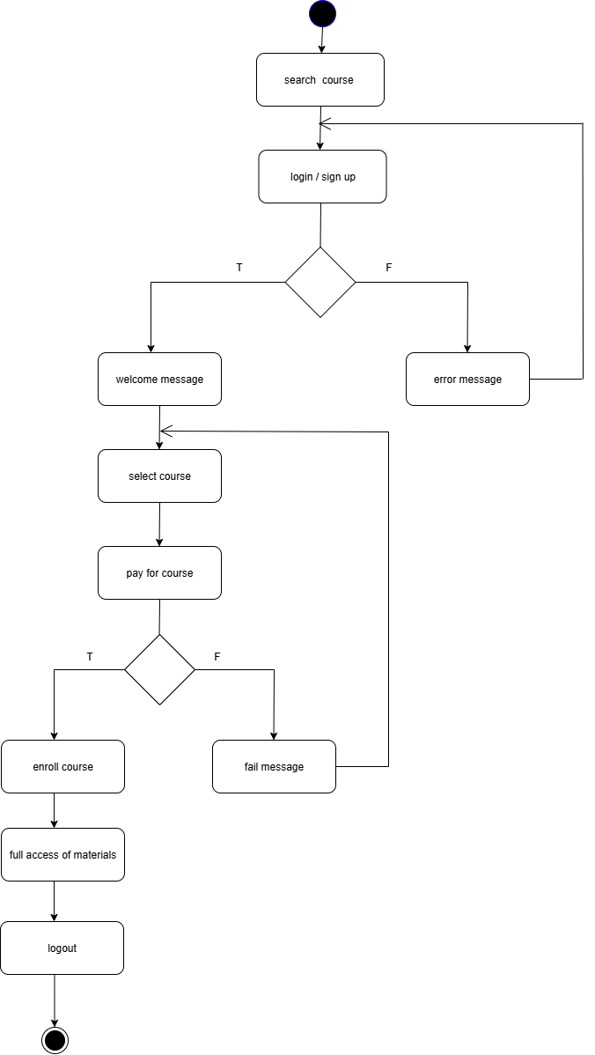
STUDENT

Slide 11
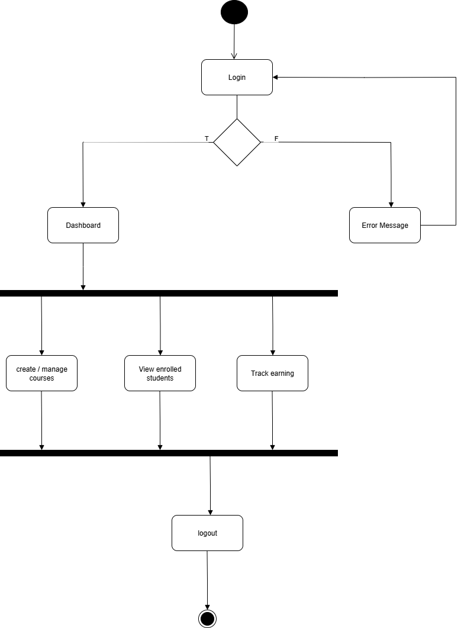
TEACHER

Slide 12
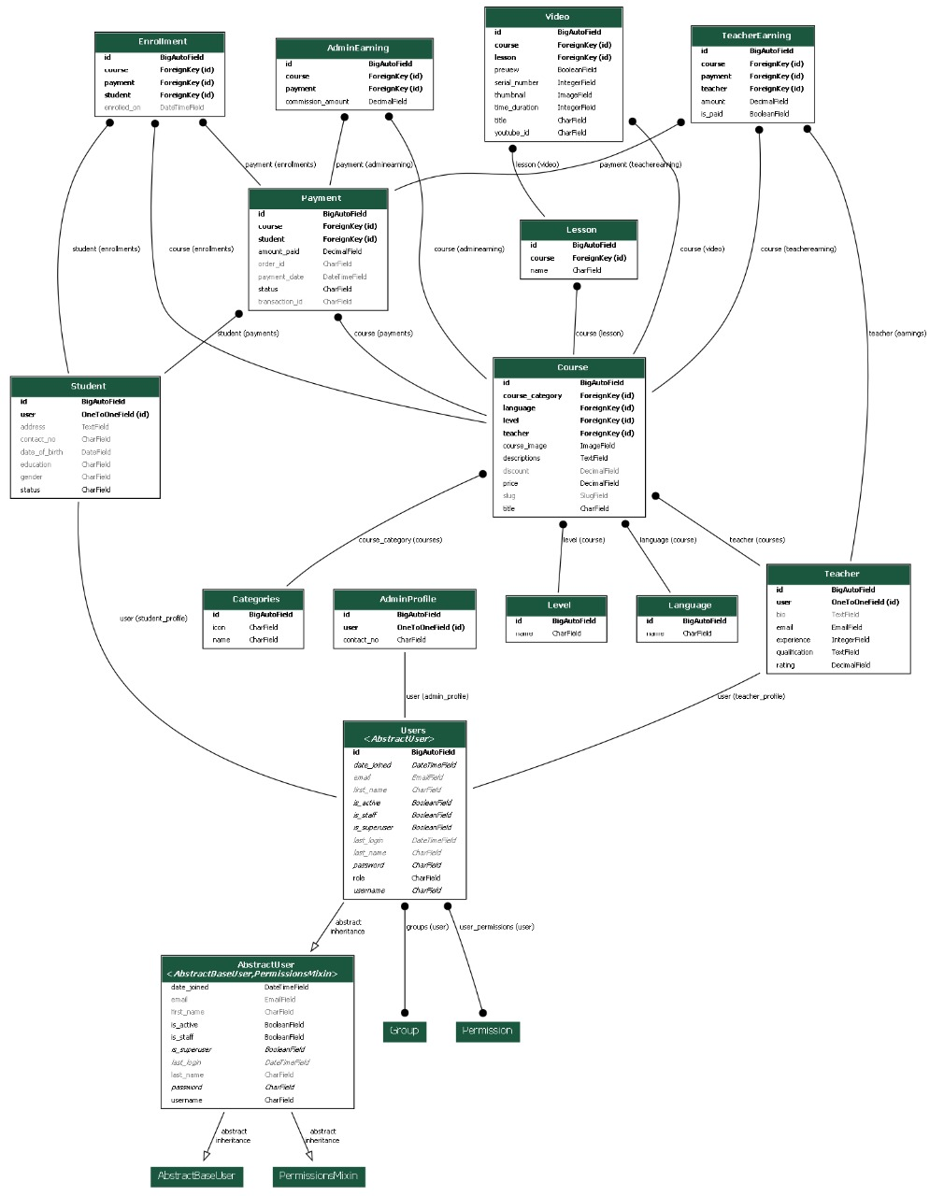
Class Diagram

Slide 13
Data Dictionary:
Field | Type | Key | Description
id | INT | PK | Unique identifier for each user
username | VARCHAR(150) | UNIQUE | Login username
email | VARCHAR(255) | UNIQUE | User email address
password | VARCHAR(255) |  | Hashed password
role | ENUM('student','teacher','admin') |  | Defines user role
Users
Field | Type | Key | Description
id | INT | PK | Unique identifier for each student
user_id | INT | FK | Links to Users.id
contact_no | VARCHAR(20) |  | Student contact number
address | TEXT |  | Residential address
date_of_birth | DATE |  | Birth date
gender | ENUM('Male','Female','Other') |  | Gender of student
education | VARCHAR(200) |  | Education qualification
status | ENUM('active','inactive') |  | Active/inactive status
Student:

Slide 14
Field | Type | Key | Description
id | INT | PK | Unique identifier for each teacher
user_id | INT | FK | Links to Users.id
email | VARCHAR(255) |  | Teacher email
qualification | TEXT |  | Academic qualification
experience | INT |  | Years of teaching experience
rating | DECIMAL(3,2) |  | Teacher rating
bio | TEXT |  | Short biography
Teacher
Field | Type | Key | Description
id | INT | PK | Unique identifier for each admin profile
user_id | INT | FK | Links to Users.id
contact_no | VARCHAR(20) |  | Admin contact number
AdminProfile

Slide 15
Field | Type | Key | Description
id | INT | PK | Unique identifier for each category
name | VARCHAR(200) |  | Category name
icon | VARCHAR(200) |  | Category icon name
Categories
Field | Type | Key | Description
id | INT | PK | Unique identifier for each level
name | VARCHAR(200) |  | Level name
Level
Field | Type | Key | Description
id | INT | PK | Unique identifier for each language
name | VARCHAR(200) |  | Language name
Language

Slide 16
Course
Field | Type | Key | Description
id | INT | PK | Unique identifier for each course
course_image | VARCHAR(255) |  | Course image path
teacher_id | INT | FK | Links to Teacher.id
title | VARCHAR(255) |  | Course title
descriptions | TEXT |  | Detailed course description
course_category | INT | FK | Links to Categories.id
level_id | INT | FK | Links to Level.id
language_id | INT | FK | Links to Language.id
slug | VARCHAR(500) | UNIQUE | SEO friendly URL
price | DECIMAL(10,2) |  | Course price
discount | DECIMAL(5,2) |  | Discount on course

Slide 17
Field | Type | Key | Description
id | INT | PK | Unique identifier for each lesson
course_id | INT | FK | Links to Course.id
name | VARCHAR(200) |  | Lesson title
Lesson
Field | Type | Key | Description
id | INT | PK | Unique identifier for each video
serial_number | INT |  | Order number of video
thumbnail | VARCHAR(255) |  | Video thumbnail path
course_id | INT | FK | Links to Course.id
lesson_id | INT | FK | Links to Lesson.id
title | VARCHAR(200) |  | Video title
youtube_id | VARCHAR(200) |  | YouTube video identifier
time_duration | INT |  | Length of video in minutes
preview | BOOLEAN |  | Is video free preview?
Video

Slide 18
Field | Type | Key | Description
id | INT | PK | Unique identifier for each payment
student_id | INT | FK | Links to Student.id
course_id | INT | FK | Links to Course.id
amount_paid | DECIMAL(10,2) |  | Amount paid
status | ENUM('successful','failed') |  | Payment status
payment_date | DATETIME |  | Date of payment
transaction_id | VARCHAR(255) |  | Transaction reference ID
order_id | VARCHAR(255) |  | Order reference ID
Payment
Field | Type | Key | Description
id | INT | PK | Unique identifier for commission record
course_id | INT | FK | Links to Course.id
payment_id | INT | FK | Links to Payment.id
commission_amount | DECIMAL(10,2) |  | Admin commission amount
AdminEarning

Slide 19
Field | Type | Key | Description
id | INT | PK | Unique identifier for enrollment
student_id | INT | FK | Links to Student.id
course_id | INT | FK | Links to Course.id
payment_id | INT | FK | Links to Payment.id
enrolled_on | DATETIME |  | Enrollment date
Enrollment
Field | Type | Key | Description
id | INT | PK | Unique identifier for earning record
teacher_id | INT | FK | Links to Teacher.id
course_id | INT | FK | Links to Course.id
payment_id | INT | FK | Links to Payment.id
amount | DECIMAL(10,2) |  | Earning amount
is_paid | BOOLEAN |  | Whether earning is paid
TeacherEarning

Slide 20
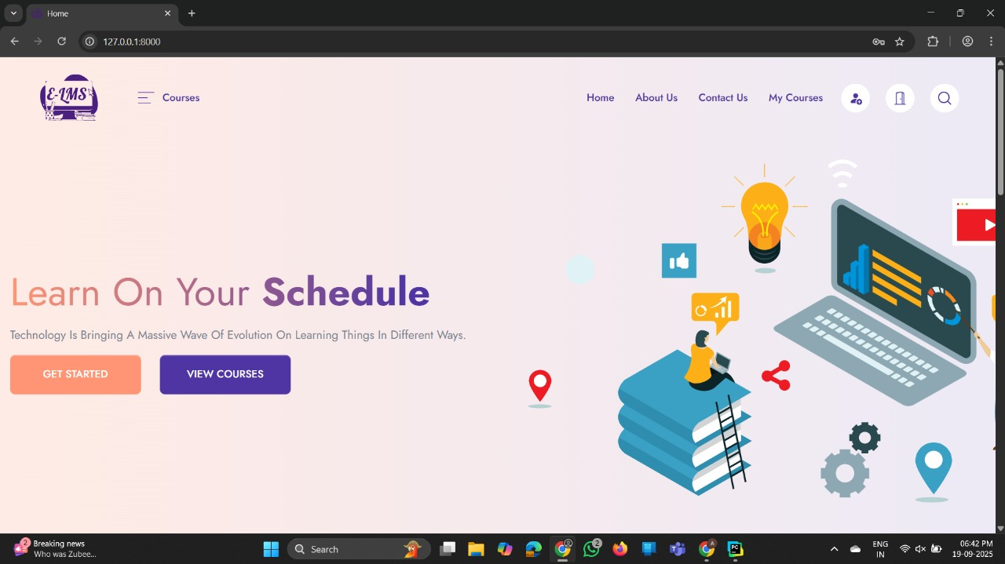
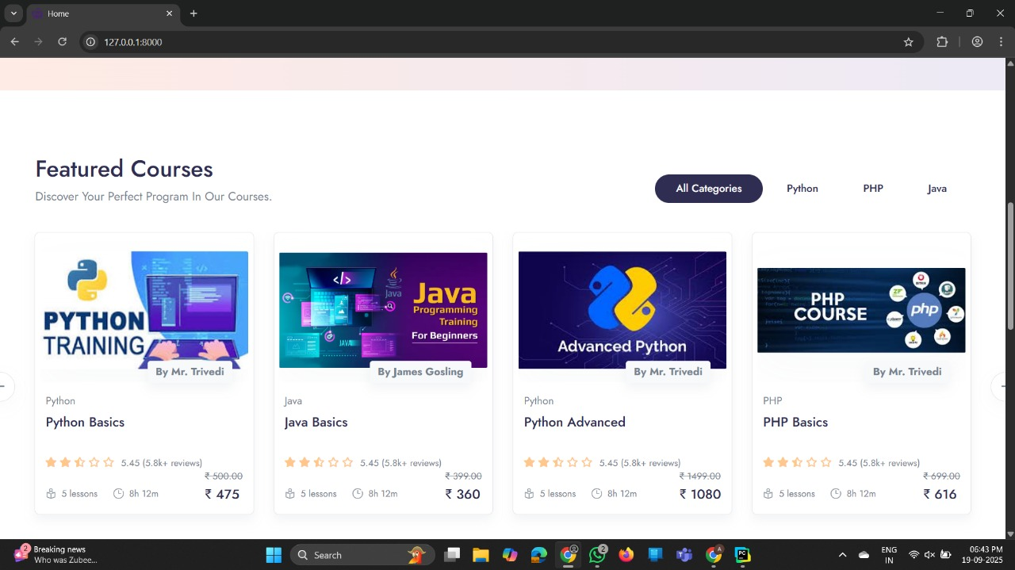
Screen Layouts
INDEX

Slide 21
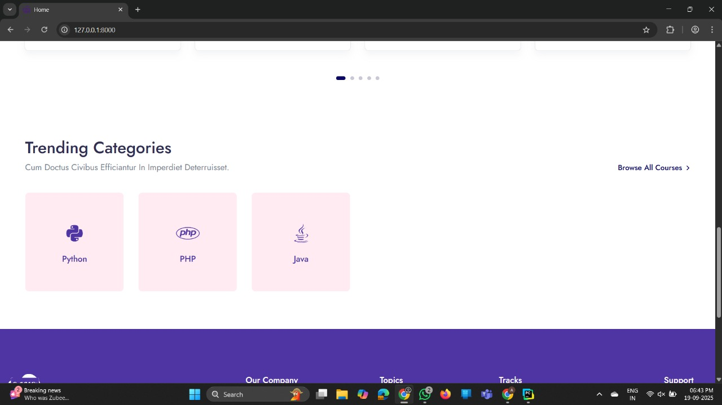
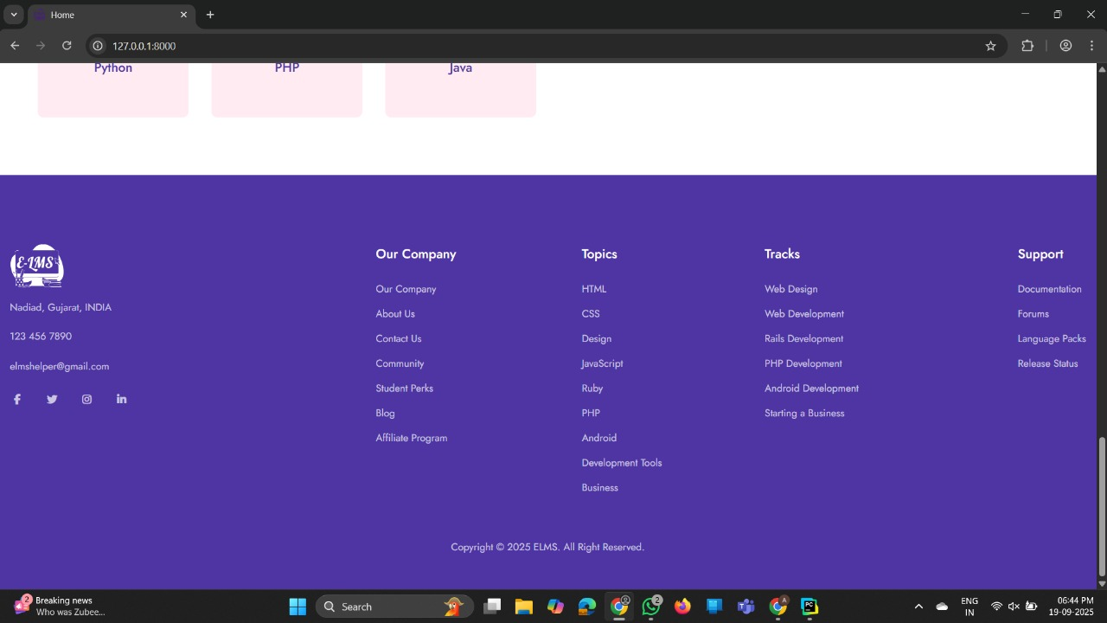

Slide 22
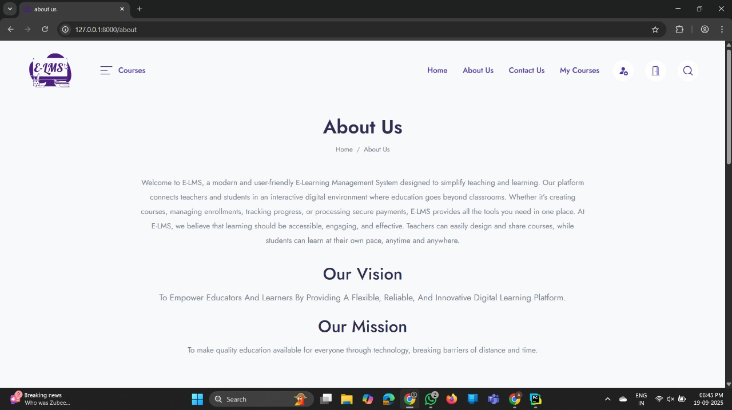
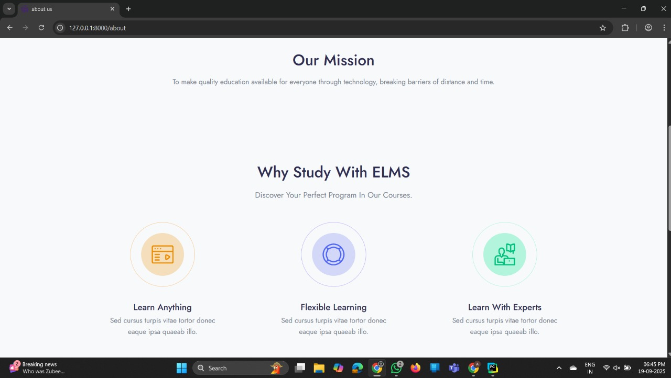
ABOUT US

Slide 23
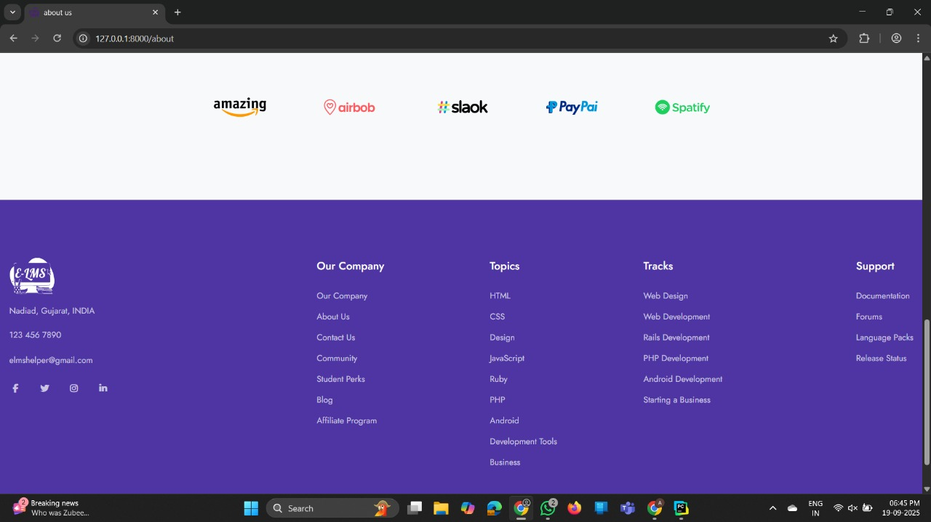
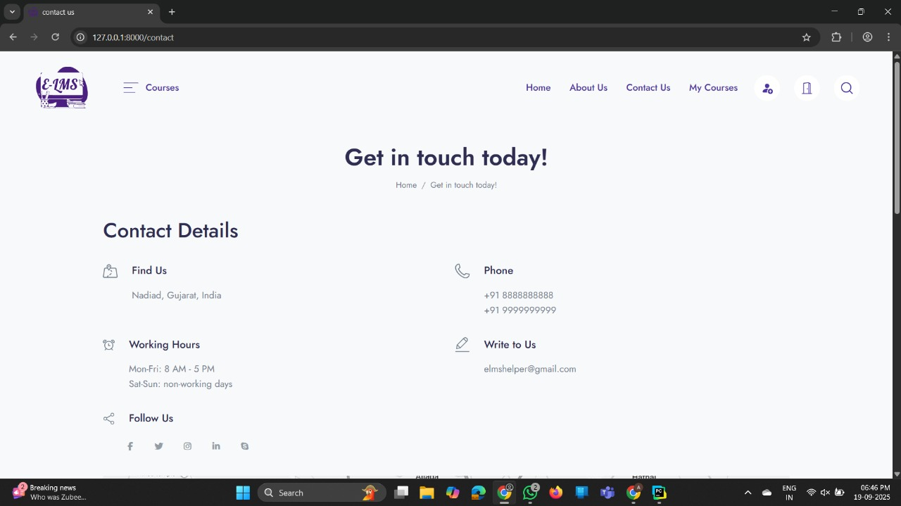
CONTACT

Slide 24
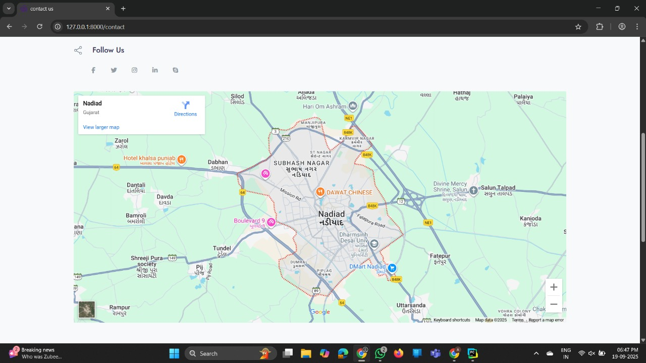
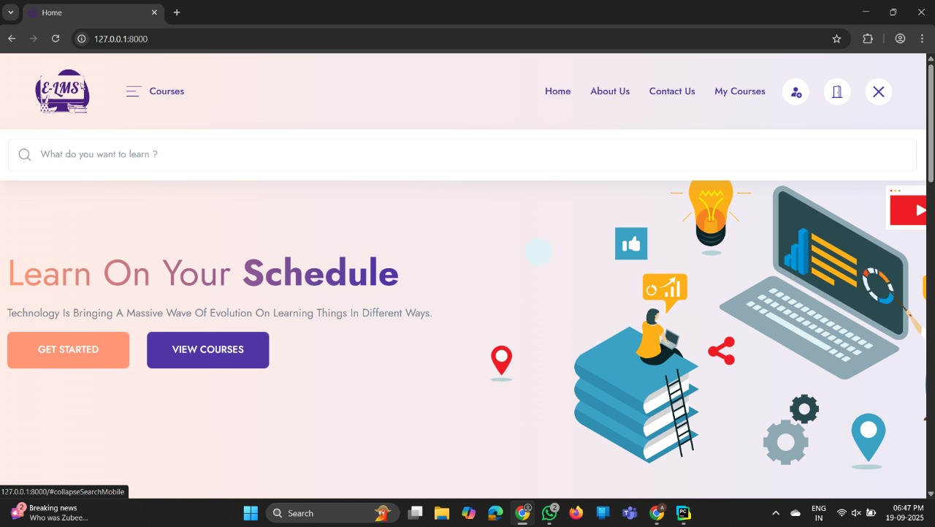
INDEX_SEARCH

Slide 25
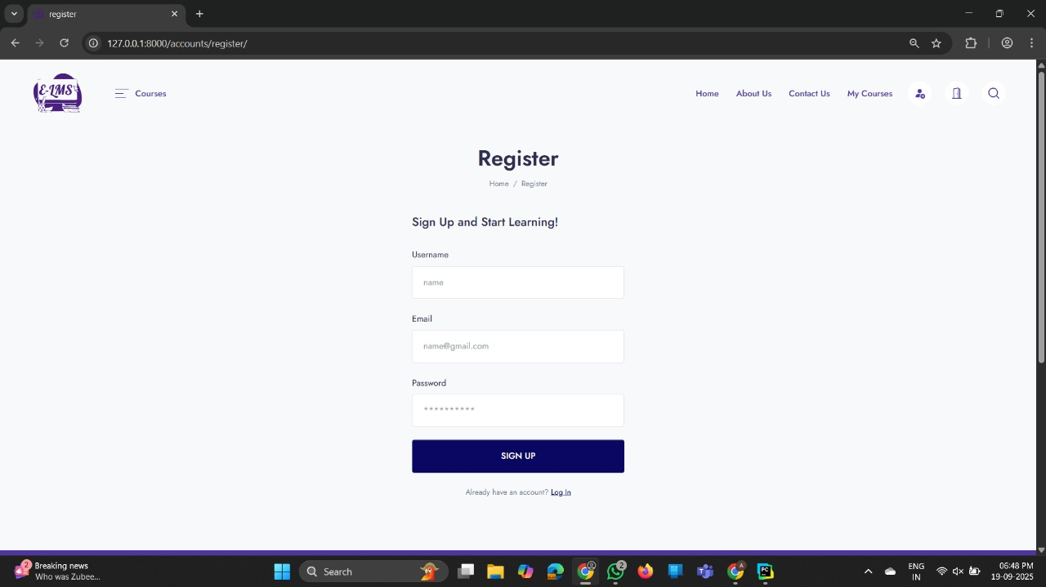
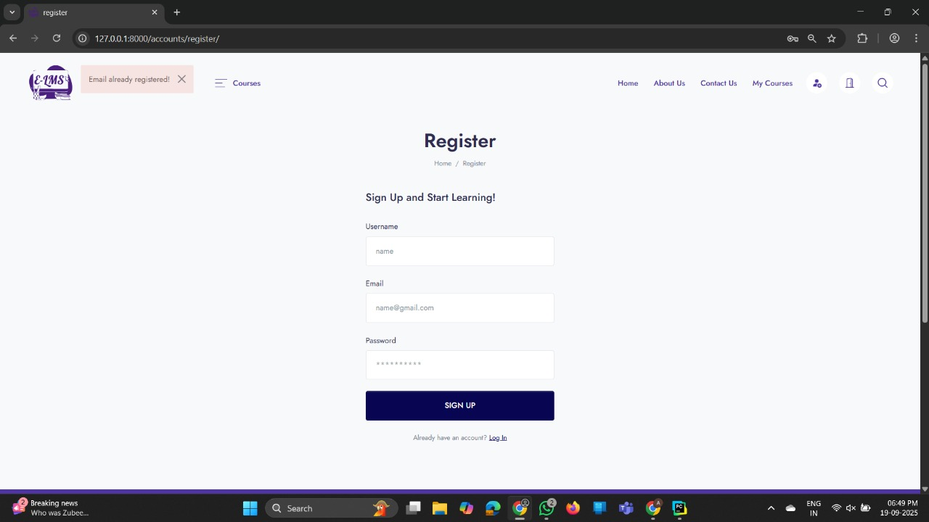
REGISTER

Slide 26
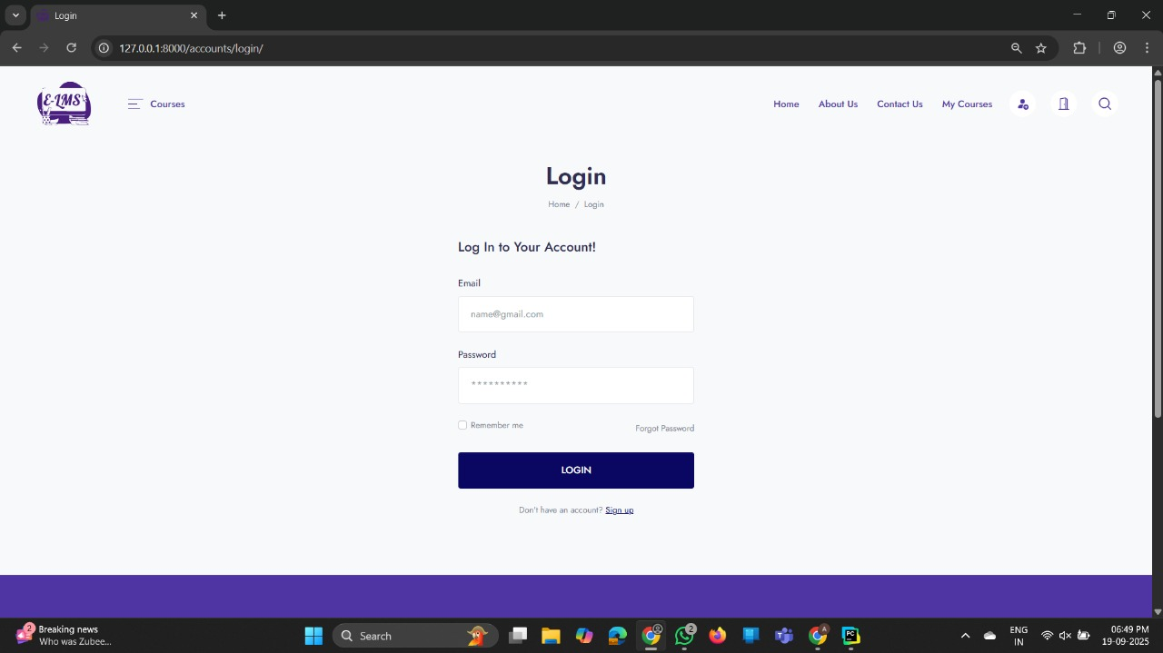
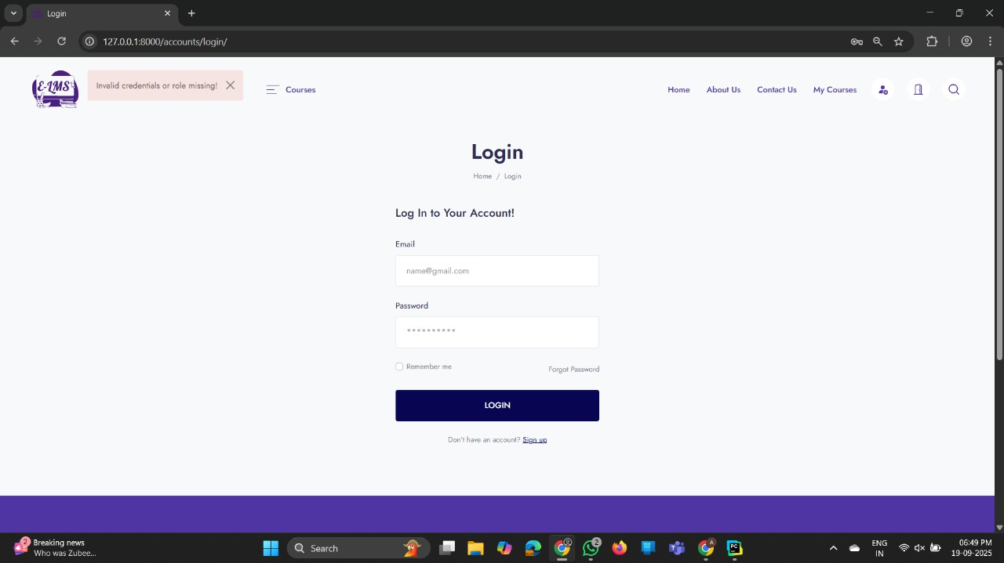
LOGIN

Slide 27
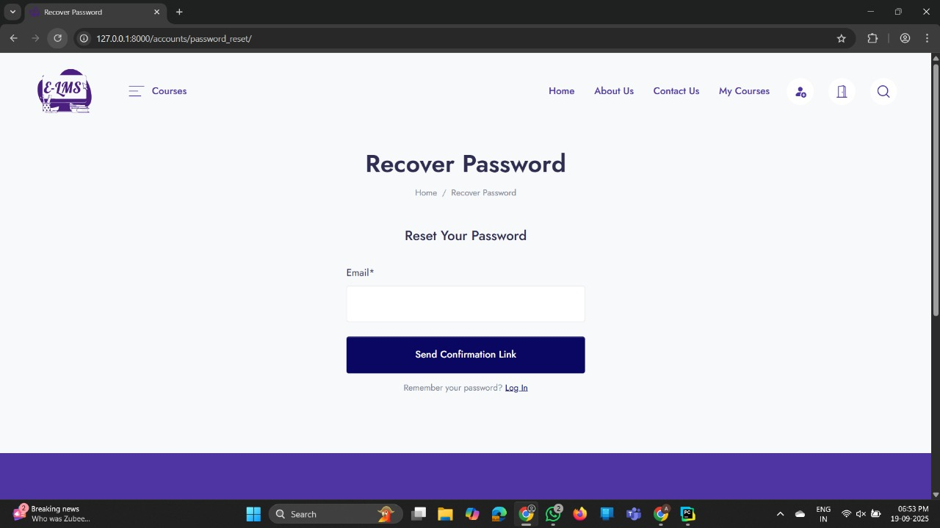
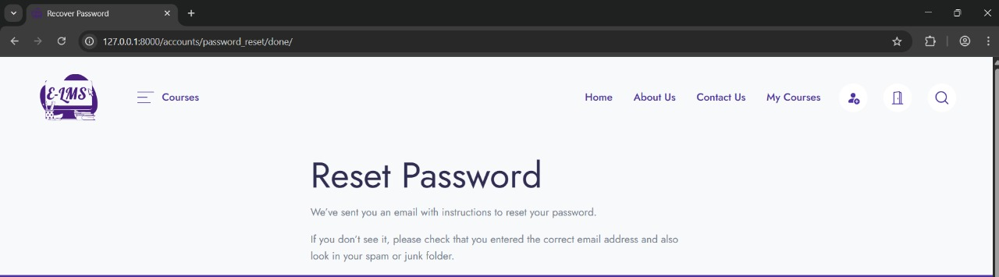
RECOVER PASSWORD

Slide 28
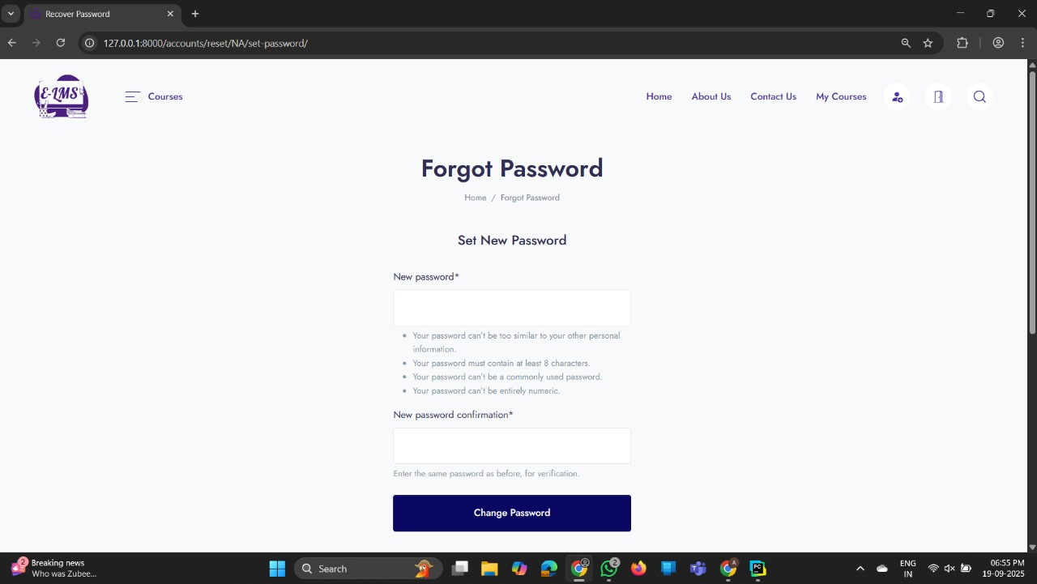
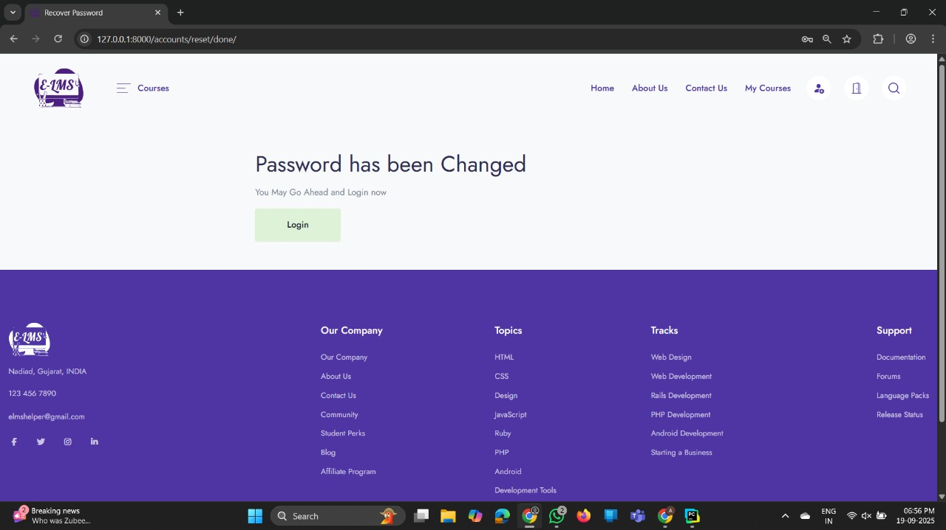

Slide 29
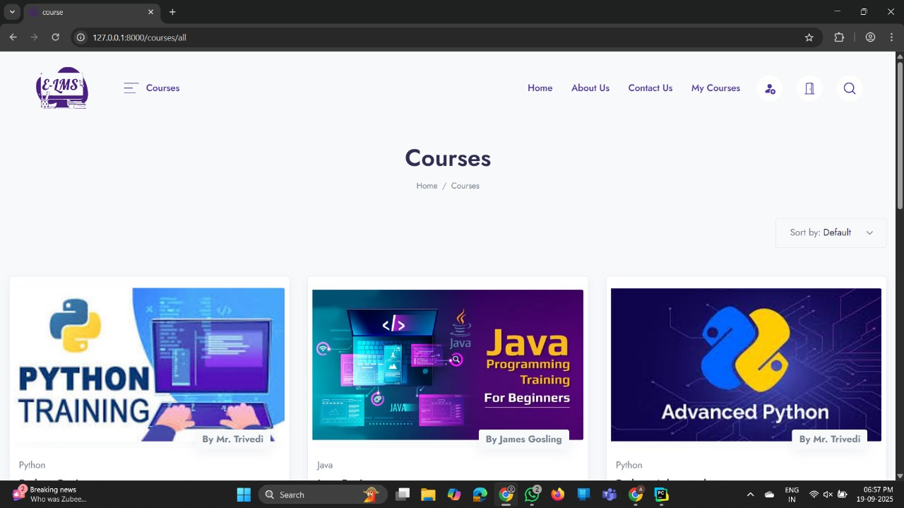
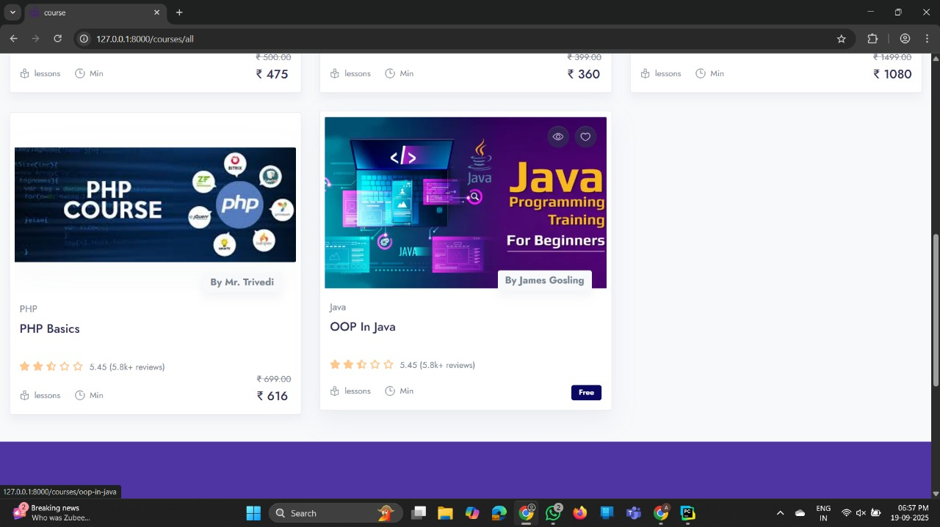
ALL COURSES (INDEX)

Slide 30
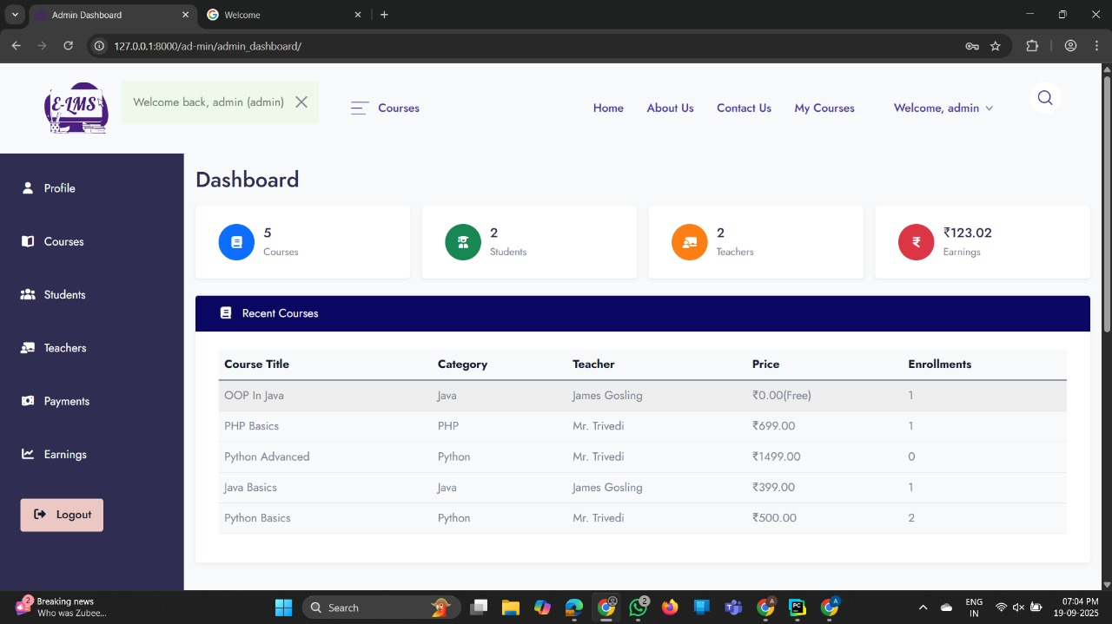
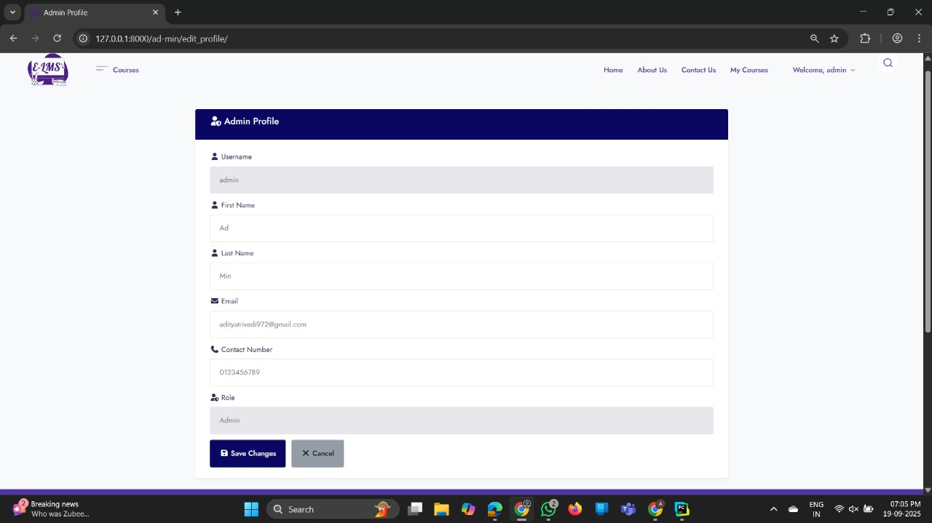
ADMIN
PROFILE

Slide 31
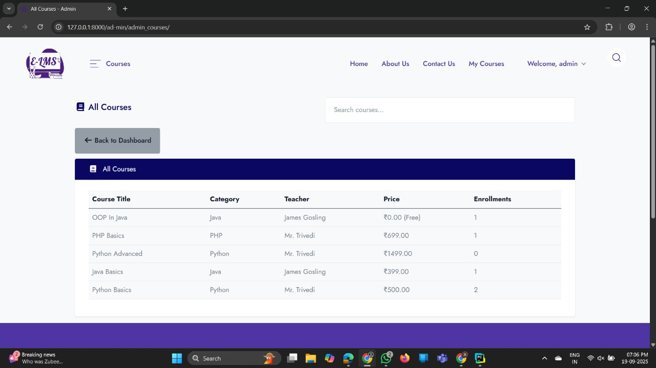
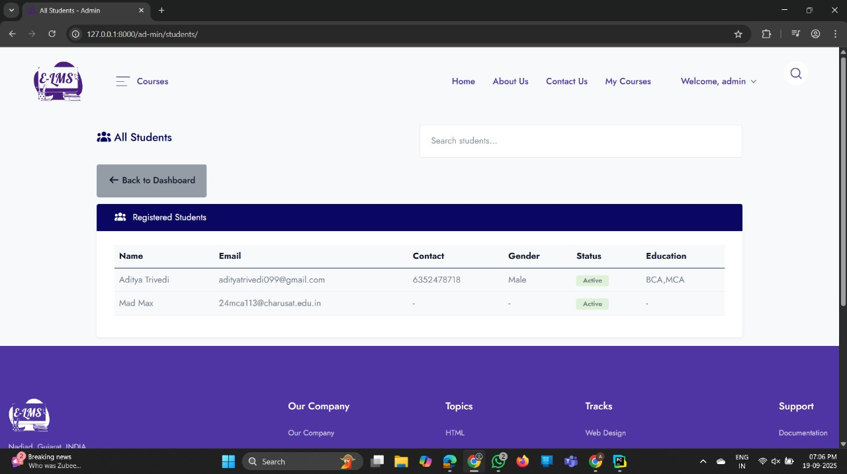
COURSE
STUDENT

Slide 32
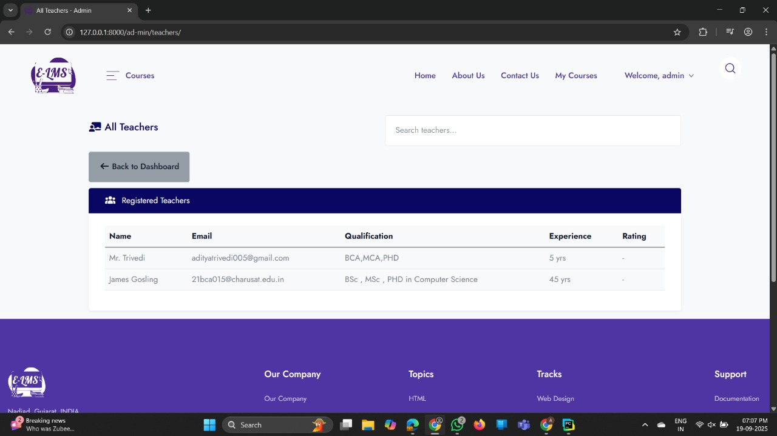
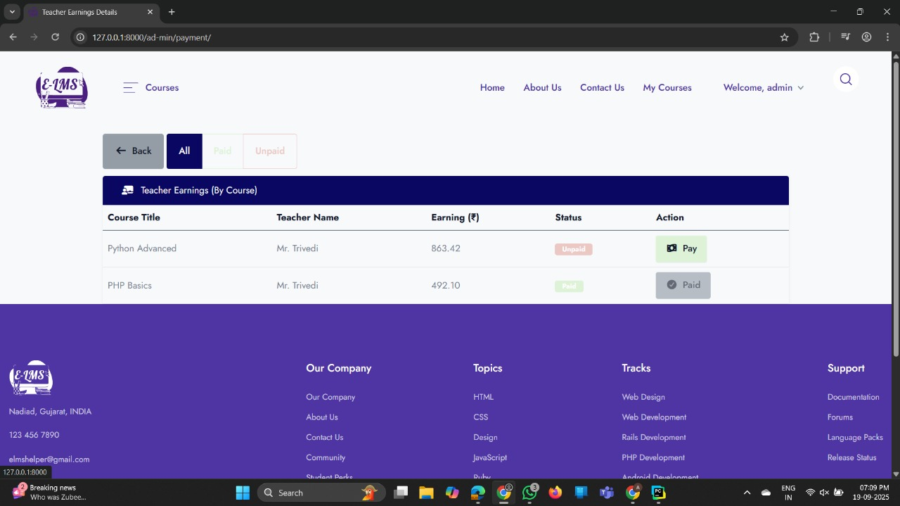
TEACHER
Dashboard_Payments

Slide 33
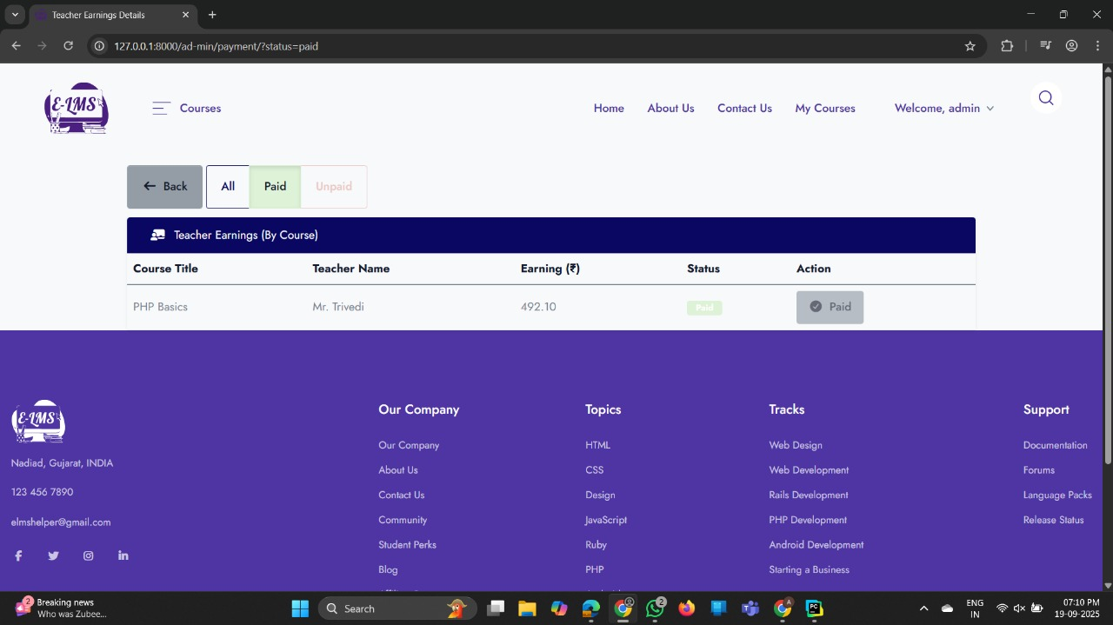
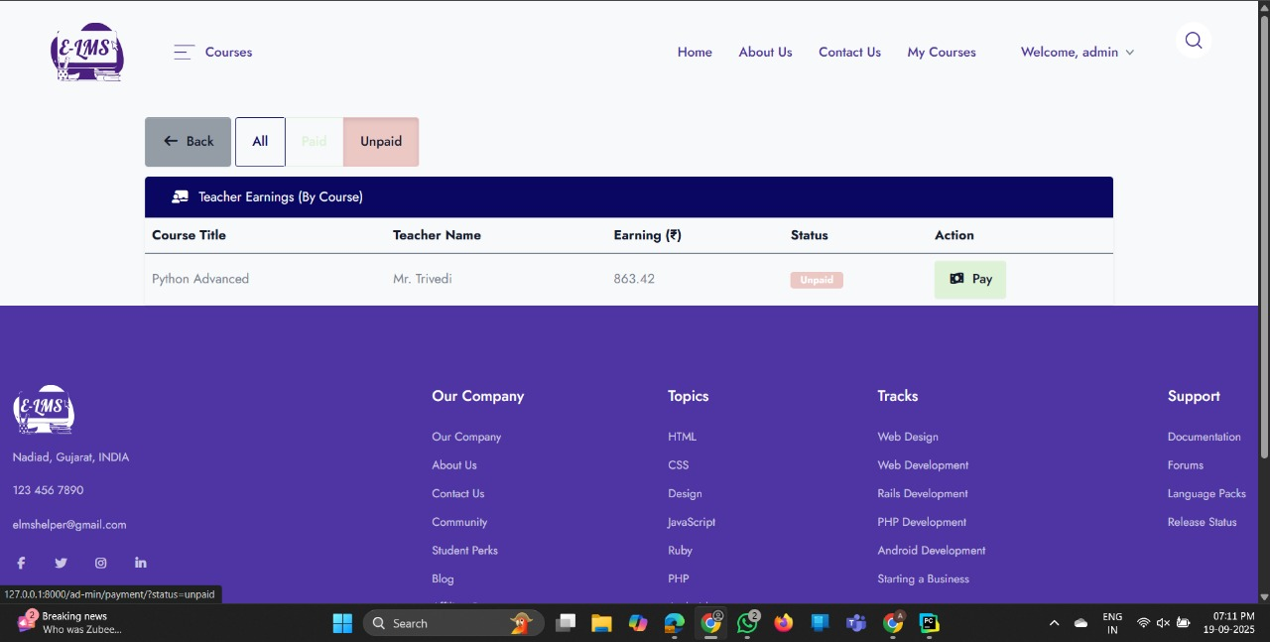

Slide 34
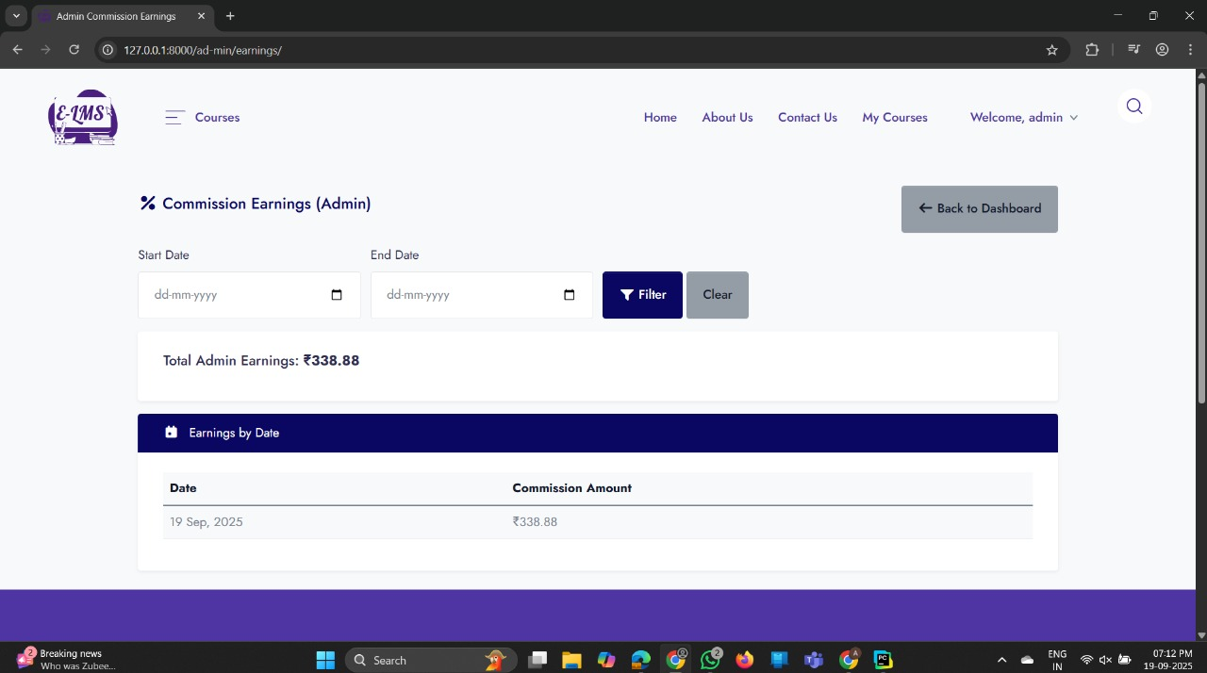
Dashboard_ Earnings

Slide 35
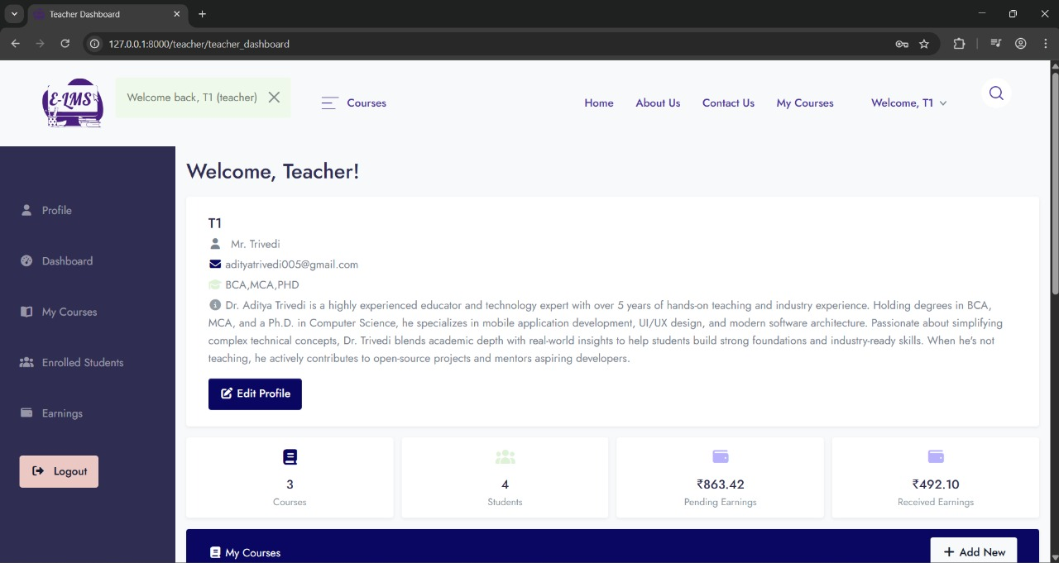
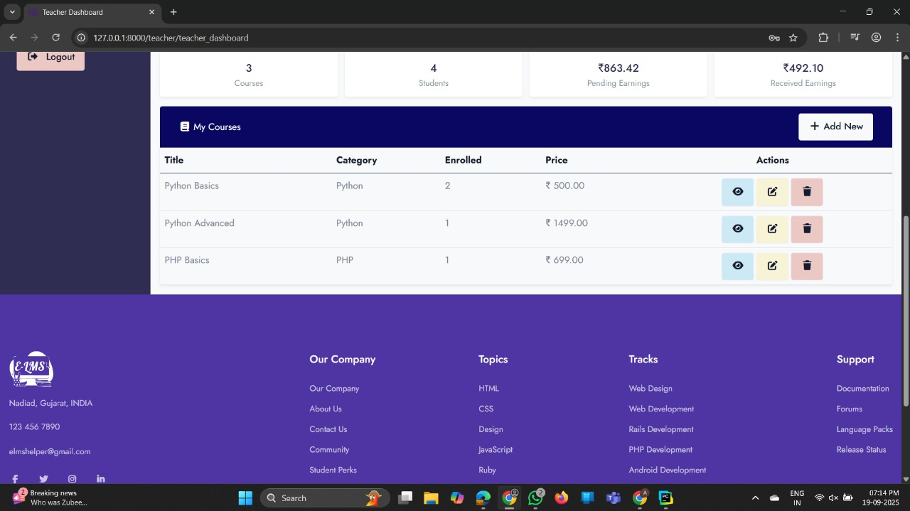
TEACHER
DASHBOARD

Slide 36
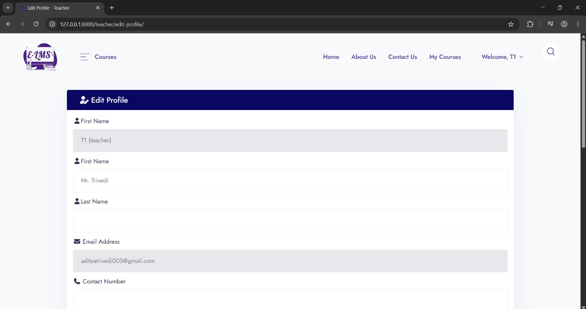
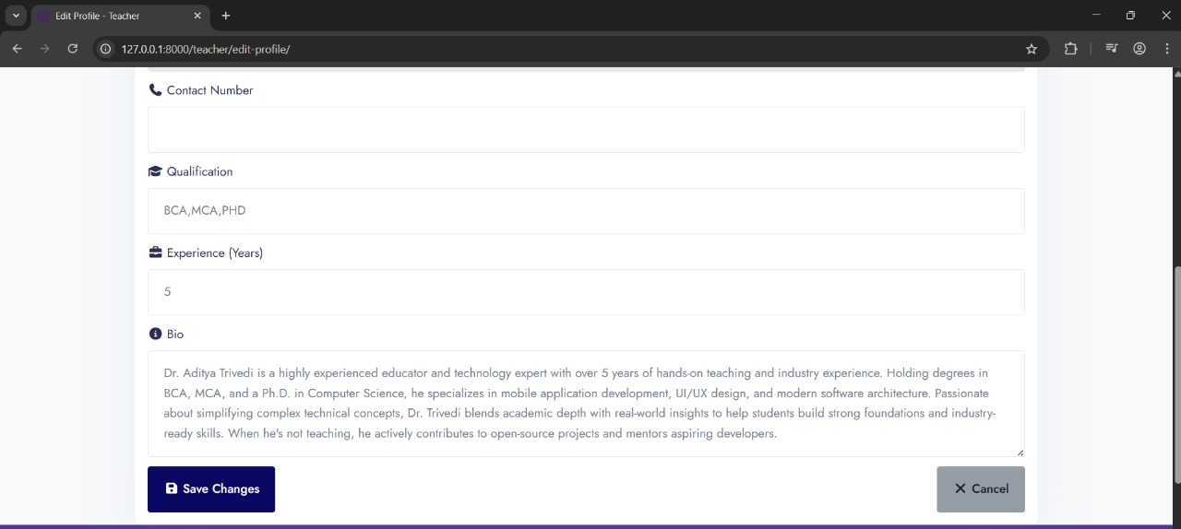
PROFILE

Slide 37
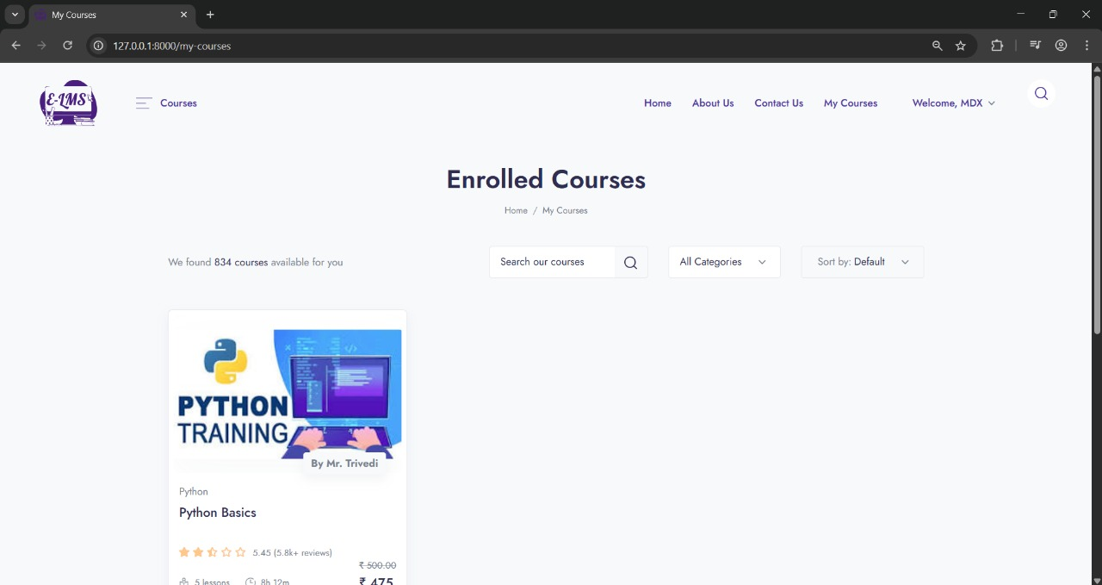
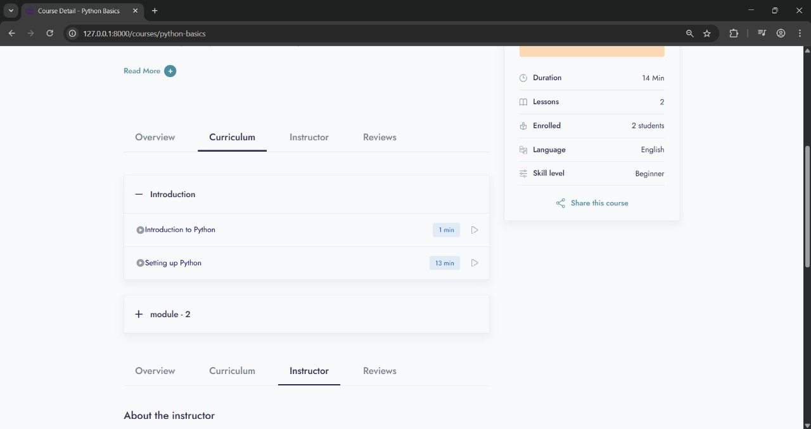
STUDENT
Student_Enrolled_Courses

Slide 38
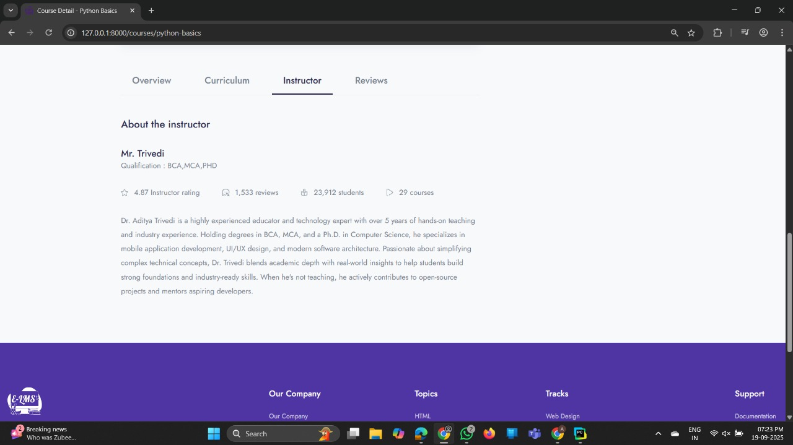
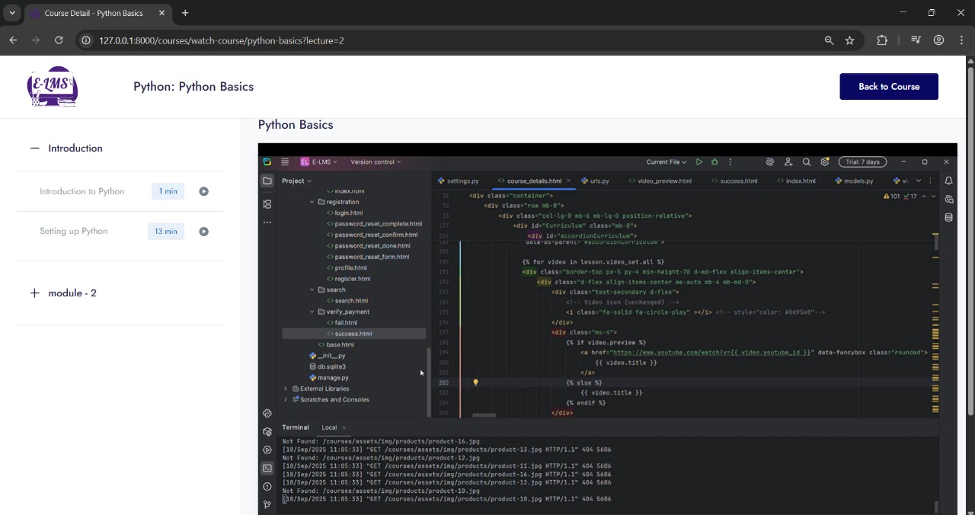

Slide 39
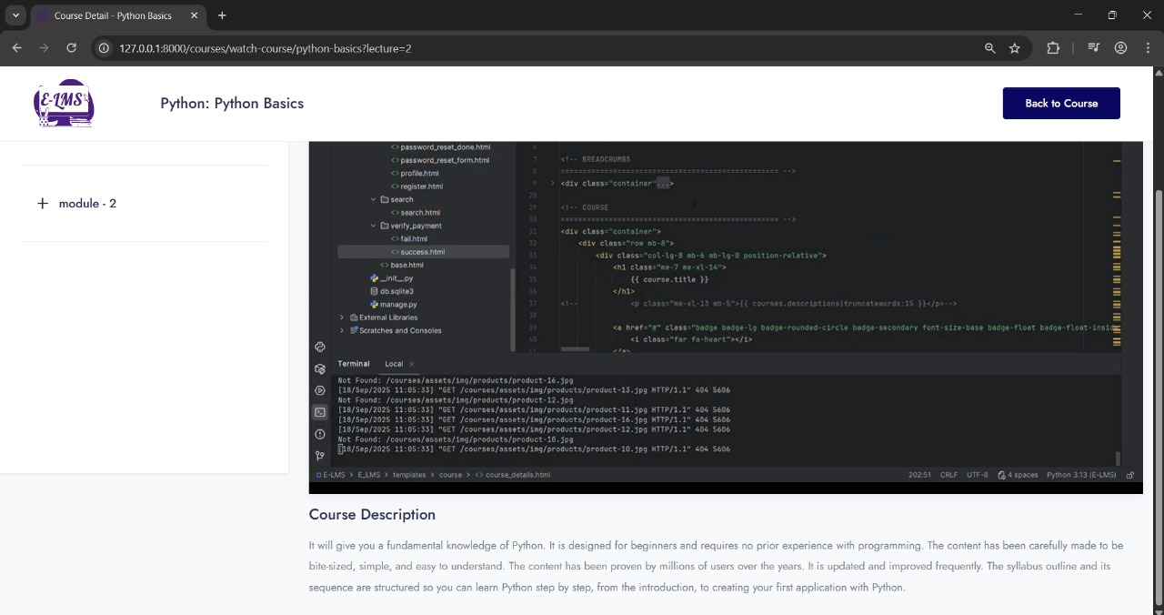

Slide 40
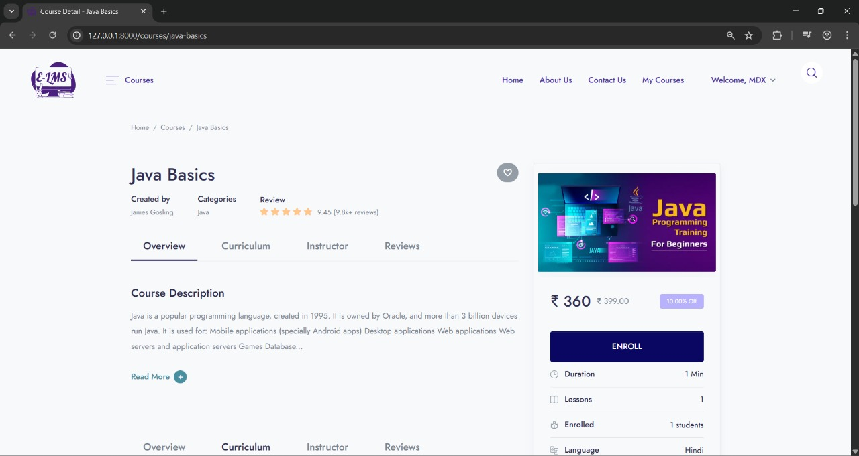
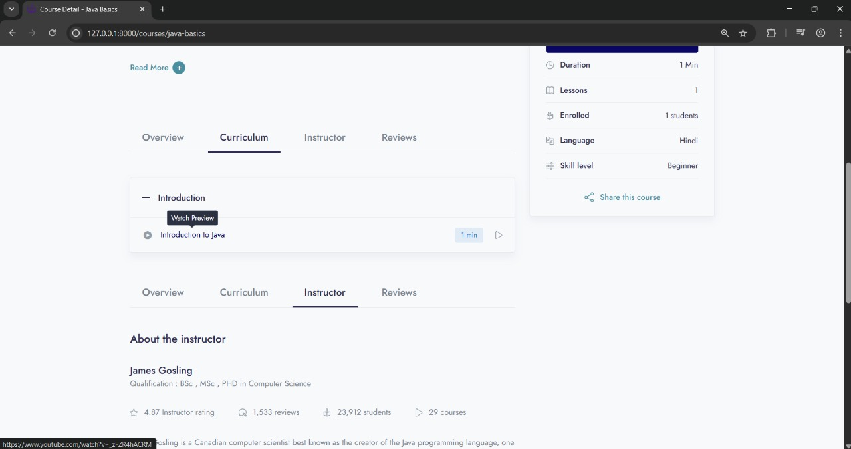

Slide 41
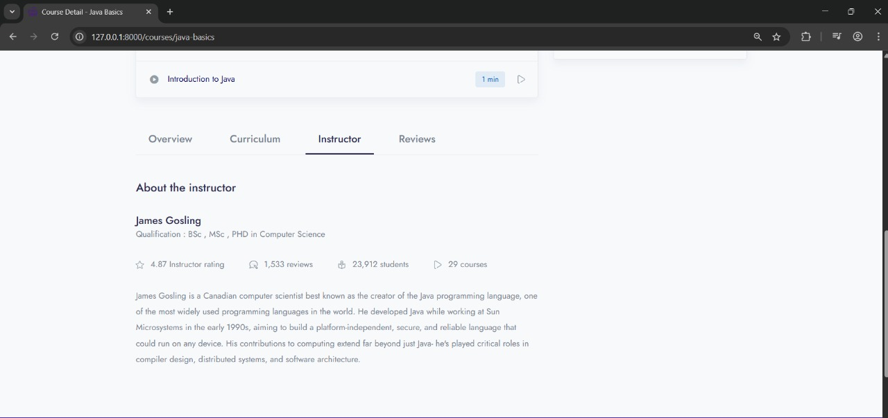
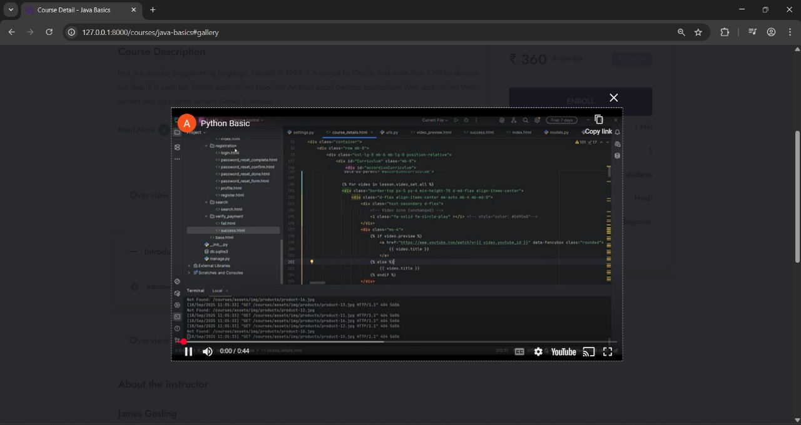
STUDENT_ENROLLED_COURSE(PREVIEW)

Slide 42
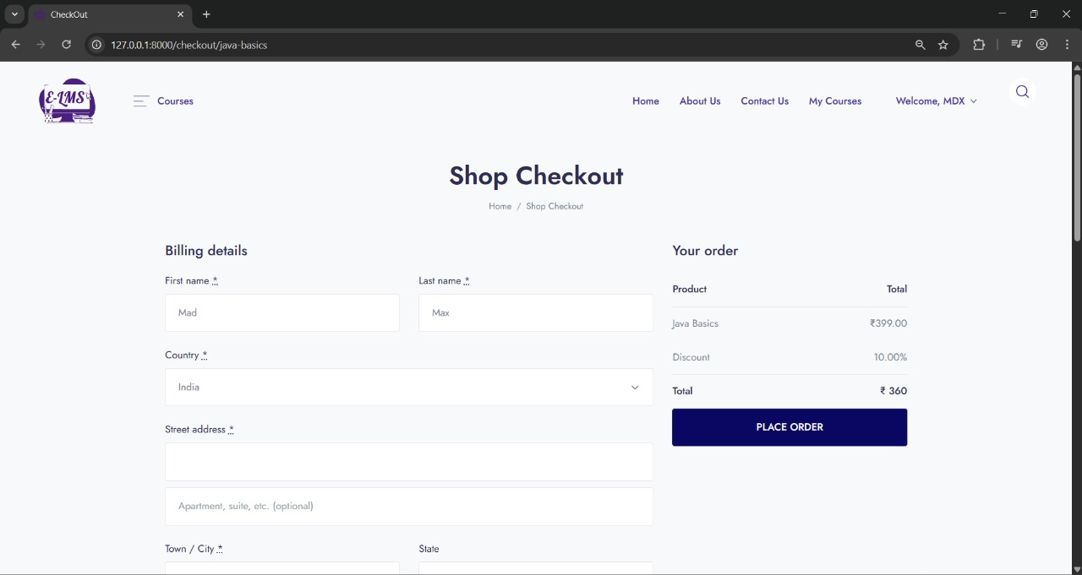

STUDENT_CHECKOUT

Slide 43



Slide 44


PAYMENT_FAILED

Slide 45

PAYMENT_SUCCESS

Slide 46

System Testing
Test Cases :

Slide 47


Slide 48
Future Enhancements
Planned Features:
Quiz & Assessment Module
Live Class Integration
Assignment Submission & Evaluation
Certificate Generation
Advanced Analytics & Dashboards
In-App Chat & Forums
Gamification Elements
Multi-language Support
AI-based Recommendations

Slide 49
Bibliography / References
Web References:
YouTube.com
Razorpay.com
W3Schools.com
Bootstrap.com
Fontawesome.com

Slide 50
THANK YOU

